Slide 1
Deadlocks

Slide 2
Objectives
To develop a description of deadlocks,
which prevent sets of concurrent processes from completing their tasks
To present a number of different methods for
preventing or
avoiding deadlocks in a computer system

Slide 3
System Model
System consists of finite no of resources
To be distributed among a number of competing processes
Resources are partitioned into several types,
Each consisting of some number of identical instances.

Slide 4
System Model
Resource types –
Memory space
CPU cycles
Files
I/0 devices (such as printers and DVD drives)
If a system has two CPUs,
then the resource type CPU has two instances

Slide 5
System Model
Resource types R₁, R₂, . . ., R_{m}
Each resource type R_{i} has W_{i} instances.
A process may utilize a resource in only the following sequence:
request
use
release

Slide 6
System Model
Request
The process requests the resource.
If the request cannot be granted immediately
If the resource is being used by another process
then the requesting process must wait until it can acquire the resource
Use
The process can operate on the resource
If the resource is a printer, the process can print on the printer
Release
The process releases the resource.

Slide 7
Deadlock
A set of processes is in a deadlocked state when
every process in the set is waiting for an event that can be caused only by another process in the set.
The events with which we are concerned are
resource acquisition and
release

Slide 8
Deadlock
The resources may be either
physical resources (for example, printers, tape drives, memory space, and CPU cycles) or
logical resources (for example, files, semaphores, and monitors).

Slide 9
Deadlock involving the same resource type
Consider a system with 3 CD RW drives and 3 processes.
Each process holds one CD RW drives.
If each process now requests another drive
The three processes will be in a deadlocked state.
Each is waiting for the event "CD RW drive is released," which can be caused by one of the other waiting processes.
Deadlock involving the same resource type.

Slide 10
Deadlock involving different resources
Deadlocks may also involve different resource types.
Consider a system with one printer and one DVD drive. Suppose that
Process Pi is holding the DVD drive
Process Pj is holding the printer.
If Pi requests the printer
If Pj requests the DVD drive,
A deadlock occurs.

Slide 11
Deadlock Characterization
Deadlock can arise if the following four conditions hold simultaneously.
Mutual exclusion
Hold and wait
No preemption
Circular wait

Slide 12
Deadlock Characterization
Deadlock can arise if four conditions hold simultaneously.
Mutual exclusion:
Only one process at a time can use a resource
If another process requests that resource, the requesting process must be delayed until the resource has been released
Hold and wait:
A process holding at least one resource is waiting to acquire additional resources held by other processes

Slide 13
Deadlock Characterization
Deadlock can arise if four conditions hold simultaneously.
No preemption
Resources cannot be preempted
A resource can be released only voluntarily by the process holding it, after that process has completed its task
Circular wait
There exists a set {P₀, P₁, …, P_{n}} of waiting processes such that
P₀ is waiting for a resource that is held by P₁,
P₁ is waiting for a resource that is held by P₂, …,
P_{n–1} is waiting for a resource that is held by P_{n},
P_{n} is waiting for a resource that is held by P₀.

Slide 14
Deadlock with Mutex Locks
Deadlocks can occur via system calls, locking, etc.

Slide 15
Resource-Allocation Graph
A set of vertices V and a set of edges E.
V is partitioned into two types:
P = {P₁, P₂, …, P_{n}},
the set consisting of all the processes in the system
R = {R₁, R₂, …, R_{m}},
the set consisting of all resource types in the system

Slide 16
Resource-Allocation Graph
A set of vertices V and a set of edges E.
request edge –
directed edge P_{i} → R_{j}
P_{i} Process requested an instance of Resource type R_{j}
P_{i} is currently waiting for that resource
assignment edge –
directed edge R_{j} → P_{i}
R_{j} Resource has been allocated to Process P_{i}

Slide 17
Resource-Allocation Graph (Cont.)
Process
Resource Type with 4 instances-
Resource may have more than 1 instance
Each such instance is a dot within the square

Slide 18
Resource-Allocation Graph (Cont.)
P_{i} requests instance of R_{j}
Request edge points only to the square
P_{i} is holding an instance of R_{j}
Assignment edge also designates one of the dots in the square
P_{i}
R_{j}
P_{i}
R_{j}

Slide 19
Resource-Allocation Graph (Cont.)
P_{i} requests instance of R_{j}
When process requests , the request edge is inserted in the graph
When request is granted, request edge is transformed to assignment edge the resource
When Resource not needed, assignment edge is deleted
P_{i}
R_{j}
P_{i}
R_{j}

Slide 20
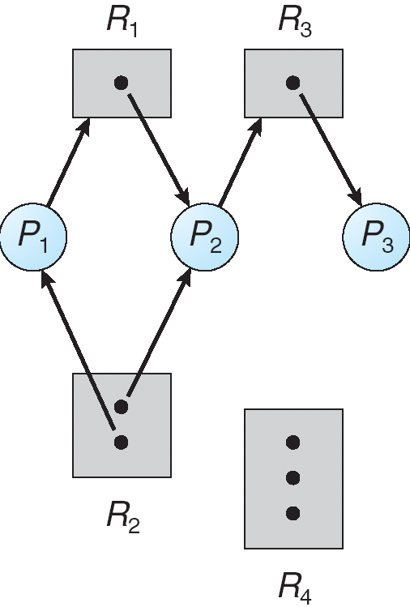
Example of a Resource Allocation Graph

Slide 21
Example of a Resource Allocation Graph
Sets P,R,E
P={P1,P2,P3}
R={R1,R2,R3}
Resource Instances
R1=1 Instance
R2=2 instances
R3=1 instances
R4=3 instances

Slide 22
Example of a Resource Allocation Graph
Process states:
Process P1 is holding an instance of resource type R2 and is waiting for an instance of resource type R1 .
Process P2 is holding an instance of R1 and an instance of R2 and is waiting for an instance of R3.
Process P3 is holding an instance of R3 .
E={P1->R1,P2->R3,R1->P2,
R2->P2,R2->P1,R3->P3}

Slide 23
Basic Facts
If graph contains no cycles ⇒ no deadlock
If graph contains a cycle ⇒
Deadlock may exist
if only one instance per resource type, then deadlock
In this case, cycle is both necessary and sufficient condition for deadlock
if several instances per resource type, possibility of deadlock
In this case, cycle is necessary but not sufficient condition for existence of deadlock

Slide 24
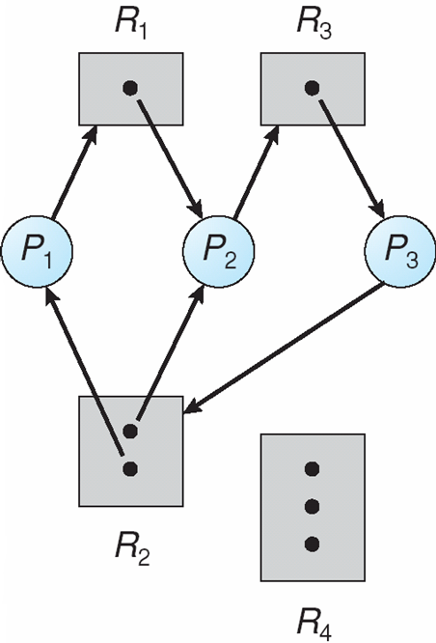
Resource Allocation Graph With A Deadlock
If P3 requests an instance of resource R2?
Since no resource instance is free, a request edge P3->R2 is added

Slide 25
Resource Allocation Graph With A Deadlock
So, Now Two cycles exist –
P1->R1->P2->R3->P3->R2->P1
P2->R3->P3->R2->P2
P1,P2,P3 are deadlocked

Slide 26
Resource Allocation Graph With A Deadlock
P1,P2,P3 are deadlocked
Process P2 is waiting for the resource R3, which is held by process P3. Process P3 is waiting for either process P1 or process P2 to release resource R2.
In addition, process P1 is waiting for process P2 to release resource R1.
Circular Wait

Slide 27
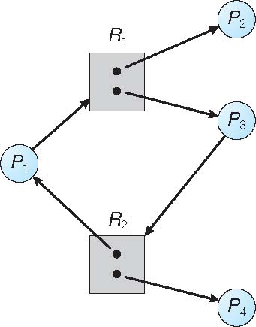
Resource Allocation Graph With A Cycle But No Deadlock
One cycle exist –
P1->R1->P3->R2->P1
Still No Deadlock
?

Slide 28
Resource Allocation Graph With A Cycle But No Deadlock
Still No Deadlock
P4 may release its instance of resource R2, which can be allocated to P3
Thus, Breaking the cycle

Slide 29
Methods for Handling Deadlocks
Ensure that the system will never enter a deadlock state:
Deadlock prevention
Deadlock avoidance

Slide 30
Methods for Handling Deadlocks
If the system does not apply either a Deadlock prevention or Deadlock avoidance,
then deadlock may occur

Slide 31
Methods for Handling Deadlocks
Deadlock Recovery
Then Allow the system to enter a deadlock state and then recover
Ignore the problem and pretend that deadlocks never occur in the system;
used by most operating systems, including UNIX

Slide 32
Deadlock Prevention

Slide 33
Deadlock Prevention
Restrain the ways request can be made
Prevent the occurrence of a deadlock
Provides a set of methods for ensuring that
at least one of the necessary conditions cannot hold.
by constraining how requests for resources can be made.

Slide 34
Deadlock Prevention
Restrain the ways request can be made
Mutual Exclusion –
ME not required for sharable resources (e.g., read-only files);
Eg-If several processes attempt to open a read-only file at the same time, they can be granted simultaneous access to the file.

Slide 35
Deadlock Prevention
Restrain the ways request can be made
Mutual Exclusion –
ME must hold for non-sharable resources
Eg- A printer cannot be simultaneously shared by several processes.

Slide 36
Deadlock Prevention
Restrain the ways request can be made
Hold and Wait
Must guarantee that whenever a process requests a resource,
it does not hold any other resources

Slide 37
Deadlock Prevention
Hold and Wait
Method 1
Require process to request and be allocated all its resources
before it begins execution,
Implement this provision by requiring that system calls requesting resources for a process
precede all other system calls.

Slide 38
Deadlock Prevention
Hold and Wait
Method 2
allow process to request resources
only when the process has none allocated to it.
A process may request some resources and use them
Before it can request any additional resources
It must release all the resources that it is currently allocated.

Slide 39
Deadlock Prevention
Hold and Wait- Difference between these two protocols
Consider a process that
copies data from a DVD drive to a file on disk,
sorts the file, and
then prints the results to a printer.

Slide 40
Deadlock Prevention
Hold and Wait- Difference between these two protocols
Method 1
If all resources must be requested at the beginning of the process,
The process must initially request the DVD drive, disk file, and printer.
It will hold the printer for its entire execution, even though it needs the printer only at the end.

Slide 41
Deadlock Prevention
Hold and Wait- Difference between these two protocols
Method 2
The process to request initially only the DVD drive and disk file.
It copies from the DVD drive to the disk and then releases both the DVD drive and the disk file.
The process must then again request the disk file and the printer.
After copying the disk file to the printer, it releases these two resources
Terminates.

Slide 42
Deadlock Prevention
Hold and Wait- Difference between these two protocols
Two main disadvantages.
First Method, resource utilization may be low,
since resources may be allocated but unused for a long period.
Second Method, starvation is possible.
A process that needs several popular resources may have to wait indefinitely,
because at least one of the resources that it needs is always allocated to some other process.

Slide 43
Deadlock Prevention (Cont.)
No Preemption –
Method 1
If a process that is holding some resources requests another resource that cannot be immediately allocated to it,
then all resources currently being held are released
Preempted resources are added to the list of resources
Process will be restarted only when
it can regain its old resources, as well as
the new ones that it is requesting

Slide 44
Deadlock Prevention (Cont.)
No Preemption –
Method 2-
If a process requests some resources,
If they are not available,
check If they are allocated to some other process that is waiting for additional resources.
If so, we
preempt the desired resources from the waiting process and
allocate them to the requesting process.

Slide 45
Deadlock Prevention (Cont.)
No Preemption –
Method 2-
If the resources are
neither available
nor held by a waiting process,
the requesting process must wait.
While it is waiting,
some of its resources may be preempted,
but only if another process requests them.
A process can be restarted only
when it is allocated the new resources it is requesting and
recovers any resources that were preempted while it was waiting.

Slide 46
Deadlock Prevention (Cont.)
Circular Wait –
Impose a total ordering of all resource types,
Requires that each process requests resources in an increasing order of enumeration

Slide 47
Deadlock Prevention (Cont.)
Circular Wait
Resources R = { R1, R2, ... , Rm}
Assign to each resource type a unique integer number,
which allows us to compare two resources
to determine whether one precedes another in our ordering.
Define a one-to-one function
F: R -> N
where N is the set of natural numbers.

Slide 48
Deadlock Prevention (Cont.)
Circular Wait
For example, if the set of resource types R includes tape drives, disk drives, and printers, then the function F might be defined as follows:
F (tape drive) = 1
F (disk drive) = 5
F (printer) = 12
A process that wants to use the tape drive and printer at the same time
must first request the tape drive and then request the printer.

Slide 49
Deadlock Prevention (Cont.)
Circular Wait
A process can initially request any number of instances of a resource type, Ri.
After that, the process can request instances of resource type Rj
If and only if F(Rj) > F(Ri)

Slide 50
Deadlock Avoidance

Slide 51
Deadlock Avoidance
Disadvantages of Deadlock prevention??
Possible side effects of preventing deadlocks, are
low device utilization and
reduced system throughput.
An alternative method for avoiding deadlocks
Deadlock Avoidance
is to require additional information about how resources are to be requested

Slide 52
A priori
In Latin a priori means “what comes first.”
A priori understandings are the assumptions that come before the rest of the assessment, argument, or analysis.

Slide 53
Deadlock Avoidance
Requires that the system has some additional a priori information available
Simplest and most useful model requires that
each process declare the maximum number of resources of each type that it may need

Slide 54
Deadlock Avoidance
Given this a priori information,
it is possible to construct an algorithm
That ensures that the system will never enter a deadlocked state.
Such an algorithm defines the deadlock-avoidance approach.

Slide 55
Deadlock Avoidance
The deadlock-avoidance algorithm
dynamically examines the resource-allocation state
to ensure that there can never be a circular-wait condition
Resource-allocation state is defined by
the number of available resources,
the number of allocated resources,
and the maximum demands of the processes

Slide 56
Safe State
A state is safe if
the system can allocate resources to each process (up to its maximum) in some order and
still avoid a deadlock.
Everytime When a process requests an available resource, system must decide
if immediate allocation leaves the system in a safe state

Slide 57
Safe State
System is in safe state if there exists a sequence <P₁, P₂, …, P_{n}> of ALL the processes in the systems such that for each P_{i},
the resources that P_{i} can still request can be satisfied by currently available resources + resources held by all the P_{j}, with j < i

Slide 58
Safe State
That is:
If P_{i} resource needs are not immediately available, then P_{i} can wait until all P_{j} have finished (j < i)
When P_{j} is finished, P_{i} can obtain needed resources, execute, return allocated resources, and terminate
When P_{i} terminates, P_{i +1} can obtain its needed resources, and so on

Slide 59
Basic Facts
If a system is in safe state ⇒ no deadlocks
If a system is in unsafe state ⇒ possibility of deadlock
Avoidance ⇒ ensure that a system will never enter an unsafe state.

Slide 60
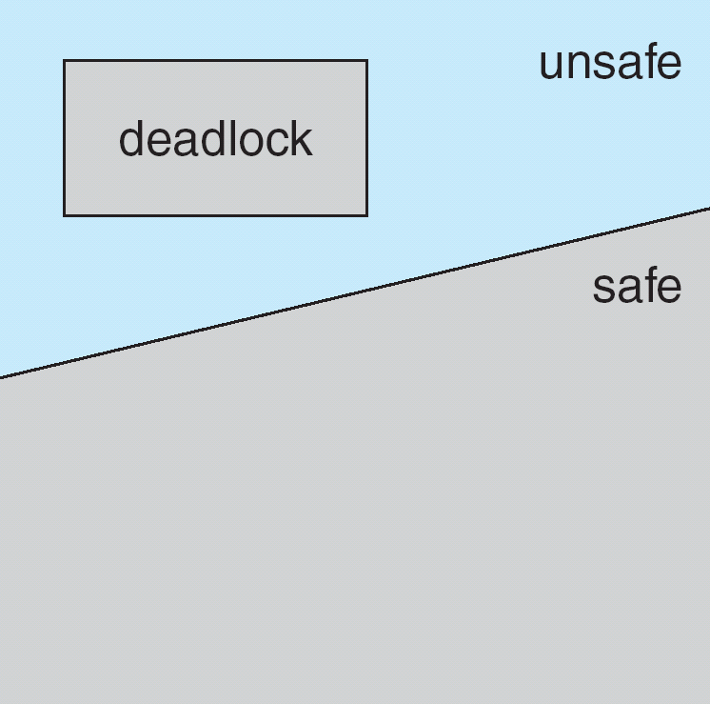
Safe, Unsafe, Deadlock State

Slide 61
Avoidance Algorithms
Single instance of a resource type
Use a resource-allocation graph
Multiple instances of a resource type
Use the banker’s algorithm

Slide 62
Resource-Allocation Graph Scheme
In addition to the request and assignment edges already described, we introduce a new type of edge, called Claim Edge
Claim edge P_{i} → R_{j} indicated that process P_{j} may request resource R_{j}; at some time in the future.
This edge resembles a request edge in direction but is represented in the graph by a dashed line.

Slide 63
Resource-Allocation Graph Scheme
Claim edge converts to request edge when a process requests a resource
Request edge converted to an assignment edge when the resource is allocated to the process
When a resource is released by a process, assignment edge reconverts to a claim edge
Resources must be claimed a priori in the system
That is, before process P; starts executing, all its claim edges must already appear in the resource-allocation graph.

Slide 64
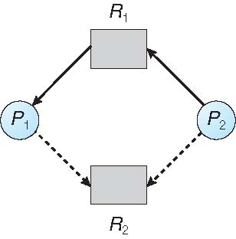
Resource-Allocation Graph

Slide 65
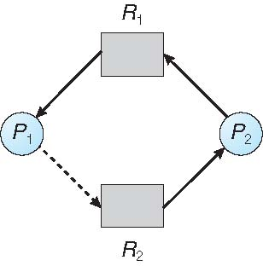
Unsafe State In Resource-Allocation Graph

Slide 66
Resource-Allocation Graph Algorithm
Suppose that process P_{i} requests a resource R_{j}
The request can be granted only
if converting the request edge to an assignment edge
does not result in the formation of a cycle in the resource allocation graph

Slide 67
Banker’s Algorithm
Multiple instances
Each process must a priori claim maximum use
This number may not exceed the total number of resources in the system.

Slide 68
Banker’s Algorithm
When a process requests a resource it may have to wait
When a process gets all its resources it must return them in a finite amount of time

Slide 69
Banker’s Algorithm
A resource allocation and deadlock avoidance algorithm.
This algorithm test for safety simulating
the allocation for predetermined maximum possible amounts of all resources,
then makes an “s-state” check to test for possible activities,
before deciding whether allocation should be allowed to continue.

Slide 70
Data Structures for the Banker’s Algorithm
Available:
Vector of length m.
If available [j] = k, there are k instances of resource type R_{j} available
Max:
n x m matrix.
If Max [i,j] = k, then process P_{i} may request at most k instances of resource type R_{j}
Allocation:
n x m matrix.
If Allocation[i,j] = k then P_{i} is currently allocated k instances of R_{j}
Need:
n x m matrix.
If Need[i,j] = k, then P_{i} may need k more instances of R_{j} to complete its task
Need [i,j] = Max[i,j] – Allocation [i,j]
n = number of processes
m = number of resources types.

Slide 71
Safety Algorithm
1. Let Work and Finish be vectors of length m and n, respectively. Initialize:
Work = Available
Finish [i] = false for i = 0, 1, …, n- 1
2. Find an i such that both:
(a) Finish [i] = false
(b) Need_{i} ≤ Work
(Add the process in the safe sequence)
If no such i exists, go to step 4
3. Work = Work + Allocation_{i} Finish[i] = true go to step 2
4. If Finish [i] == true for all i, then the system is in a safe state

Slide 72
Example of Banker’s Algorithm
5 processes P₀ through P₄;
3 resource types:
A (10 instances), B (5instances), and C (7 instances)
Snapshot at time T₀:
Allocation Max Available
A B C A B C A B C
P₀ 0 1 0 7 5 3 3 3 2
P₁ 2 0 0 3 2 2
P₂ 3 0 2 9 0 2
P₃ 2 1 1 2 2 2
P₄ 0 0 2 4 3 3

Slide 73
Example (Cont.)
The content of the matrix Need is defined to be Max – Allocation
Need
A B C
P₀ 7 4 3
P₁ 1 2 2
P₂ 6 0 0
P₃ 0 1 1
P₄ 4 3 1
The system is in a safe state since the sequence < P₁, P₃, P₄, P₂, P₀> satisfies safety criteria

Slide 74
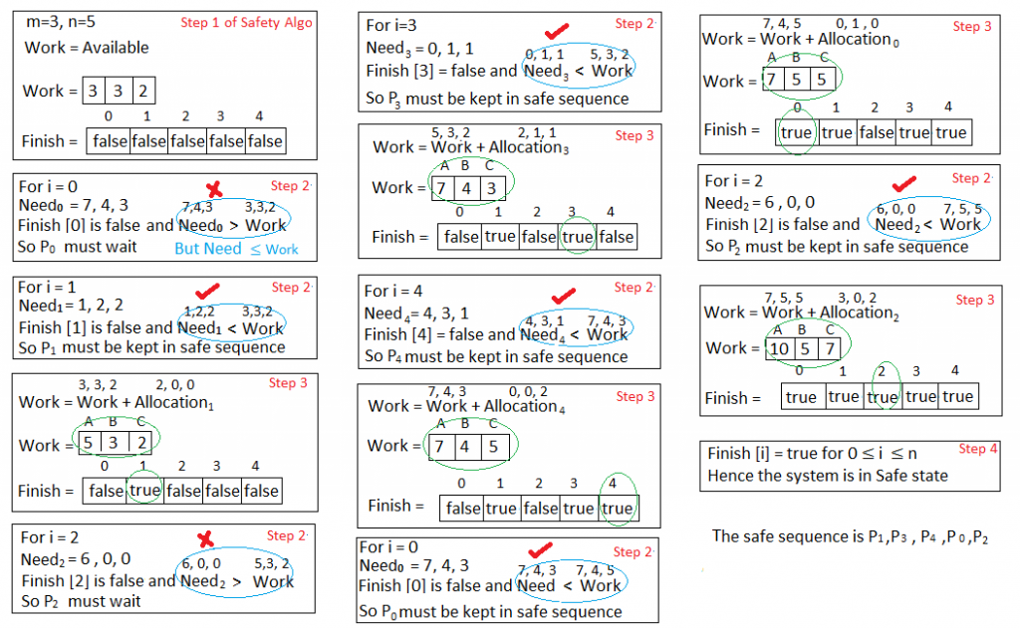
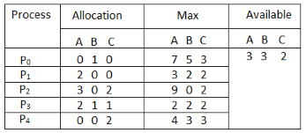
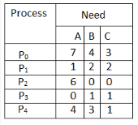
Applying the Safety algorithm on the given system,
n = number of processes
m = number of resources types
1. Let Work and Finish be vectors of length m and n, respectively. Initialize:
Work = Available
Finish [i] = false for i = 0, 1, …, n- 1

Slide 75
Applying the Safety algorithm on the given system,
n = number of processes
m = number of resources types
1. Let Work and Finish be vectors of length m and n, respectively. Initialize:
Work = Available
Finish [i] = false for i = 0, 1, …, n- 1
2. Find an i such that both:
(a) Finish [i] = false
(b) Need_{i} ≤ Work
If no such i exists, go to step 4
3. Work = Work + Allocation_{i} Finish[i] = true go to step 2
4. If Finish [i] == true for all i, then the system is in a safe state

Slide 76
Applying the Safety algorithm on the given system,
1. Let Work and Finish be vectors of length m and n, respectively. Initialize:
Work = Available
Finish [i] = false for i = 0, 1, …, n- 1
2. Find an i such that both:
(a) Finish [i] = false
(b) Need_{i} ≤ Work
If no such i exists, go to step 4
3. Work = Work + Allocation_{i} Finish[i] = true go to step 2
4. If Finish [i] == true for all i, then the system is in a safe state

Slide 77
Applying the Safety algorithm on the given system,
1. Let Work and Finish be vectors of length m and n, respectively. Initialize:
Work = Available
Finish [i] = false for i = 0, 1, …, n- 1
2. Find an i such that both:
(a) Finish [i] = false
(b) Need_{i} ≤ Work
If no such i exists, go to step 4
3. Work = Work + Allocation_{i} Finish[i] = true go to step 2
4. If Finish [i] == true for all i, then the system is in a safe state

Slide 78
Resource-Request Algorithm for Process P_{i}
Request_{i} = request vector for process P_{i}.
If Request_{i} [j] = k then process P_{i} wants k instances of resource type R_{j}
1. If Request_{i} ≤ Need_{i} go to step 2. Otherwise, raise error condition, since process has exceeded its maximum claim
2. If Request_{i} ≤ Available, go to step 3. Otherwise P_{i} must wait, since resources are not available
3. Pretend to allocate requested resources to P_{i} by modifying the state as follows:
Available = Available – Request_{i};
Allocation_{i} = Allocation_{i} + Request_{i};
Need_{i} = Need_{i} – Request_{i};
Apply Safety Algorithm
If safe ⇒ the resources are allocated to P_{i}
If unsafe ⇒ P_{i} must wait, and the old resource-allocation state is restored

Slide 79
Example: P₁ Request (1,0,2)
Check that Request ≤ Available (that is, (1,0,2) ≤ (3,3,2) ⇒ true
Allocation Need Available
A B C A B C A B C
P₀ 0 1 0 7 4 3 2 3 0
P₁ 3 0 2 0 2 0
P₂ 3 0 2 6 0 0
P₃ 2 1 1 0 1 1
P₄ 0 0 2 4 3 1
Executing safety algorithm shows that sequence < P₁, P₃, P₄, P₀, P₂> satisfies safety requirement
Can request for (3,3,0) by P₄ be granted?
Can request for (0,2,0) by P₀ be granted?

Slide 80
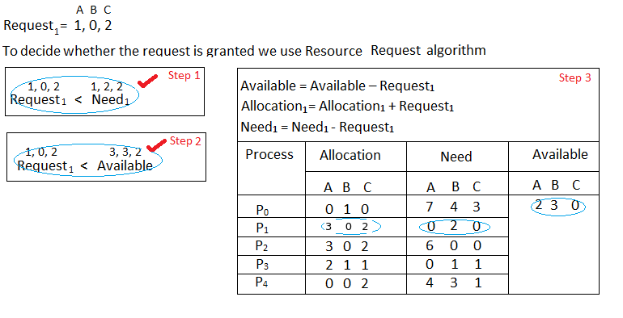
Example: Explanation
What will happen if process P1 requests one additional instance of resource type A and two instances of resource type C?

Slide 81
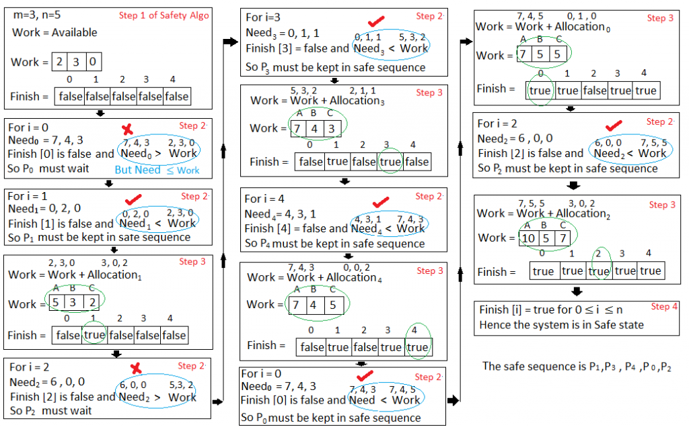
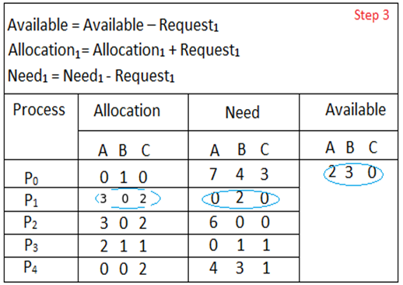
We must determine whether this new system state is safe. To do so, we again execute Safety algorithm again
1. Let Work and Finish be vectors of length m and n, respectively. Initialize:
Work = Available
Finish [i] = false for i = 0, 1, …, n- 1
2. Find an i such that both:
(a) Finish [i] = false
(b) Need_{i} ≤ Work
If no such i exists, go to step 4
3. Work = Work + Allocation_{i} Finish[i] = true go to step 2
4. If Finish [i] == true for all i, then the system is in a safe state

Slide 82
We must determine whether this new system state is safe. To do so, we again execute Safety algorithm again
1. Let Work and Finish be vectors of length m and n, respectively. Initialize:
Work = Available
Finish [i] = false for i = 0, 1, …, n- 1
2. Find an i such that both:
(a) Finish [i] = false
(b) Need_{i} ≤ Work
If no such i exists, go to step 4
3. Work = Work + Allocation_{i} Finish[i] = true go to step 2
4. If Finish [i] == true for all i, then the system is in a safe state

Slide 83
We must determine whether this new system state is safe. To do so, we again execute Safety algorithm again
1. Let Work and Finish be vectors of length m and n, respectively. Initialize:
Work = Available
Finish [i] = false for i = 0, 1, …, n- 1
2. Find an i such that both:
(a) Finish [i] = false
(b) Need_{i} ≤ Work
If no such i exists, go to step 4
3. Work = Work + Allocation_{i} Finish[i] = true go to step 2
4. If Finish [i] == true for all i, then the system is in a safe state
Hence the new system state is safe, so we can immediately grant the request for process P_{1 .}

Slide 84
Why Banker’s algorithm is named so?

Slide 85
Why Banker’s algorithm is named so?
Banker’s algorithm is named so because it is used in banking system to check whether loan can be sanctioned to a person or not.
Suppose there are n number of account holders in a bank and the total sum of their money is S.
If a person applies for a loan then the bank
first subtracts the loan amount from the total money that bank has and
if the remaining amount is greater than S then only the loan is sanctioned.

Slide 86
Why Banker’s algorithm is named so?
It is done because if all the account holders comes to withdraw their money then the bank can easily do it.
Bank would never allocate its money in such a way that it can no longer satisfy the needs of all its customers.
The bank would try to be in safe state always.

Slide 87
Consider the following snapshot of a system- Answer the following questions using the Banker’s algorithm- (i) What are the total instances of Resources (ii) What is the content of the matrix need? (iii) Is the system in a safe state? (iv) If a request from process P1 arrives for (0,4,2,0), can the request be granted immediately?
Process | Allocation |  |  |  | Max |  |  |  | Available
 | A | B | C | D | A | B | C | D | A | B | C | D
P0 | 0 | 0 | 1 | 2 | 0 | 0 | 1 | 2 | 1 | 5 | 2 | 0
P1 | 1 | 0 | 0 | 0 | 1 | 7 | 5 | 0
P2 | 1 | 3 | 5 | 4 | 2 | 3 | 5 | 6
P3 | 0 | 6 | 3 | 2 | 0 | 6 | 5 | 2
P4 | 0 | 0 | 1 | 4 | 0 | 6 | 5 | 6

Slide 88
(i) What are the total instances of Resources For A=1+1+1=3 For B=3+6+5=14 For C=1+5+3+1+2=12 For D=2+4+2+4=12
Exercise 1
Process | Allocation |  |  |  | Max |  |  |  | Available
 | A | B | C | D | A | B | C | D | A | B | C | D
P0 | 0 | 0 | 1 | 2 | 0 | 0 | 1 | 2 | 1 | 5 | 2 | 0
P1 | 1 | 0 | 0 | 0 | 1 | 7 | 5 | 0
P2 | 1 | 3 | 5 | 4 | 2 | 3 | 5 | 6
P3 | 0 | 6 | 3 | 2 | 0 | 6 | 5 | 2
P4 | 0 | 0 | 1 | 4 | 0 | 6 | 5 | 6

Slide 89
Content of the matrix need Step 1: in row of process P0, use formula Need=Max – Allocation Step 2: Follow step 1 above for all other processes i.e. P1, P2, P3, P4, P5. Result given above.
Process | Allocation |  |  |  | Max |  |  |  | Available |  |  |  | Need
 | A | B | C | D | A | B | C | D | A | B | C | D | A | B | C | D
P0 | 0 | 0 | 1 | 2 | 0 | 0 | 1 | 2 | 1 | 5 | 2 | 0 | 0 | 0 | 0 | 0
P1 | 1 | 0 | 0 | 0 | 1 | 7 | 5 | 0 |  |  |  |  | 0 | 7 | 5 | 0
P2 | 1 | 3 | 5 | 4 | 2 | 3 | 5 | 6 |  |  |  |  | 1 | 0 | 0 | 2
P3 | 0 | 6 | 3 | 2 | 0 | 6 | 5 | 2 |  |  |  |  | 0 | 0 | 2 | 0
P4 | 0 | 0 | 1 | 4 | 0 | 6 | 5 | 6 |  |  |  |  | 0 | 6 | 4 | 2

Slide 90
Work=[1,5,2,0] For P) Need ≤ Work, so Safe Sequence=<P0> Work=[1,5,2,0]+[0,0,1,2] Work=[1,5,3,2] For P1, Need is not ≤ Work P1 must wait For P2, Need ≤ Work i.e. [1,0,0,2]<[1,5,3,2] So Safe Sequence=<P0,P2> Work=[1,5,3,2]+[1,3,5,4] =[2,8,8,6]
Process | Allocation |  |  |  | Max |  |  |  | Available |  |  |  | Need
 | A | B | C | D | A | B | C | D | A | B | C | D | A | B | C | D
P0 | 0 | 0 | 1 | 2 | 0 | 0 | 1 | 2 | 1 | 5 | 2 | 0 | 0 | 0 | 0 | 0
P1 | 1 | 0 | 0 | 0 | 1 | 7 | 5 | 0 |  |  |  |  | 0 | 7 | 5 | 0
P2 | 1 | 3 | 5 | 4 | 2 | 3 | 5 | 6 |  |  |  |  | 1 | 0 | 0 | 2
P3 | 0 | 6 | 3 | 2 | 0 | 6 | 5 | 2 |  |  |  |  | 0 | 0 | 2 | 0
P4 | 0 | 0 | 1 | 4 | 0 | 6 | 5 | 6 |  |  |  |  | 0 | 6 | 4 | 2
1. Let Work and Finish be vectors of length m and n, respectively. Initialize:
Work = Available
Finish [i] = false for i = 0, 1, …, n- 1
2. Find an i such that both:
(a) Finish [i] = false
(b) Need_{i} ≤ Work
If no such i exists, go to step 4
3. Work = Work + Allocation_{i} Finish[i] = true go to step 2
4. If Finish [i] == true for all i, then the system is in a safe state

Slide 91
Work=[2,8,8,6] For P3, Need ≤Work [0,0,2,0]<Work Safe Sequence=<P0,P2,P3> Work=[2,8,8,6]+[0,6,3,2] =[2,14,11,8] For P4, Need ≤ Work [0,6,4,2]<Work Safe Sequence=<P0,P2,P3,P4> Work=[2,14,11,8]+[0,0,1,4] =[2,14,12,12]
Process | Allocation |  |  |  | Max |  |  |  | Available |  |  |  | Need
 | A | B | C | D | A | B | C | D | A | B | C | D | A | B | C | D
P0 | 0 | 0 | 1 | 2 | 0 | 0 | 1 | 2 | 1 | 5 | 2 | 0 | 0 | 0 | 0 | 0
P1 | 1 | 0 | 0 | 0 | 1 | 7 | 5 | 0 |  |  |  |  | 0 | 7 | 5 | 0
P2 | 1 | 3 | 5 | 4 | 2 | 3 | 5 | 6 |  |  |  |  | 1 | 0 | 0 | 2
P3 | 0 | 6 | 3 | 2 | 0 | 6 | 5 | 2 |  |  |  |  | 0 | 0 | 2 | 0
P4 | 0 | 0 | 1 | 4 | 0 | 6 | 5 | 6 |  |  |  |  | 0 | 6 | 4 | 2
1. Let Work and Finish be vectors of length m and n, respectively. Initialize:
Work = Available
Finish [i] = false for i = 0, 1, …, n- 1
2. Find an i such that both:
(a) Finish [i] = false
(b) Need_{i} ≤ Work
If no such i exists, go to step 4
3. Work = Work + Allocation_{i} Finish[i] = true go to step 2
4. If Finish [i] == true for all i, then the system is in a safe state

Slide 92
Work=[2,14,12,12] Now for P1, Need ≤ Work [0,7,5,0]<Work Safe Sequence=<P0,P2,P3,P4,P1> Work=[2,14,12,12]+[1,0,0,0] =[3,14,12,12] Thus, System is in a safe state
Process | Allocation |  |  |  | Max |  |  |  | Available |  |  |  | Need
 | A | B | C | D | A | B | C | D | A | B | C | D | A | B | C | D
P0 | 0 | 0 | 1 | 2 | 0 | 0 | 1 | 2 | 1 | 5 | 2 | 0 | 0 | 0 | 0 | 0
P1 | 1 | 0 | 0 | 0 | 1 | 7 | 5 | 0 |  |  |  |  | 0 | 7 | 5 | 0
P2 | 1 | 3 | 5 | 4 | 2 | 3 | 5 | 6 |  |  |  |  | 1 | 0 | 0 | 2
P3 | 0 | 6 | 3 | 2 | 0 | 6 | 5 | 2 |  |  |  |  | 0 | 0 | 2 | 0
P4 | 0 | 0 | 1 | 4 | 0 | 6 | 5 | 6 |  |  |  |  | 0 | 6 | 4 | 2
1. Let Work and Finish be vectors of length m and n, respectively. Initialize:
Work = Available
Finish [i] = false for i = 0, 1, …, n- 1
2. Find an i such that both:
(a) Finish [i] = false
(b) Need_{i} ≤ Work
If no such i exists, go to step 4
3. Work = Work + Allocation_{i} Finish[i] = true go to step 2
4. If Finish [i] == true for all i, then the system is in a safe state

Slide 93
Deadlock Detection

Slide 94
Deadlock Detection
Allow system to enter deadlock state
Detection algorithm
examines the state of the system to determine whether a deadlock has occurred
Recovery scheme

Slide 95
Detection Algorithm
Detection Algorithm
Single Instance of all Resources Types
Several Instances of Resource Types

Slide 96
Single Instance of Each Resource Type
Detection Algorithm
If only a single instance of all resources are there,
Use a variant of the resource-allocation graph, called a wait-for graph.
Obtain this graph from the resource-allocation graph by removing the resource nodes and collapsing the appropriate edges

Slide 97
Single Instance of Each Resource Type
Maintain wait-for graph
Nodes are processes
P_{i} → P_{j} if P_{i} is waiting for P_{j}
Periodically invoke an algorithm that searches for a cycle in the graph.
If there is a cycle, there exists a deadlock
An algorithm to detect a cycle in a graph requires an order of n² operations, where n is the number of vertices in the graph

Slide 98
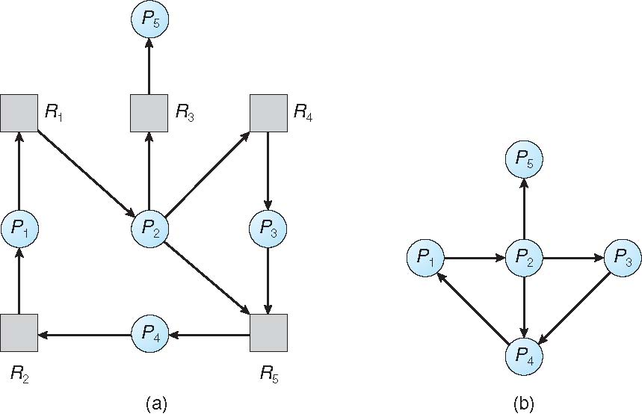
Resource-Allocation Graph and Wait-for Graph
Resource-Allocation Graph
Corresponding wait-for graph

Slide 99
Several Instances of a Resource Type
m=no of resources
n=no of processes
Available: A vector of length m indicates the number of available resources of each type
Allocation: An n x m matrix defines the number of resources of each type currently allocated to each process
Request: An n x m matrix indicates the current request of each process. If Request [i][j] = k, then process P_{i} is requesting k more instances of resource type R_{j}.

Slide 100
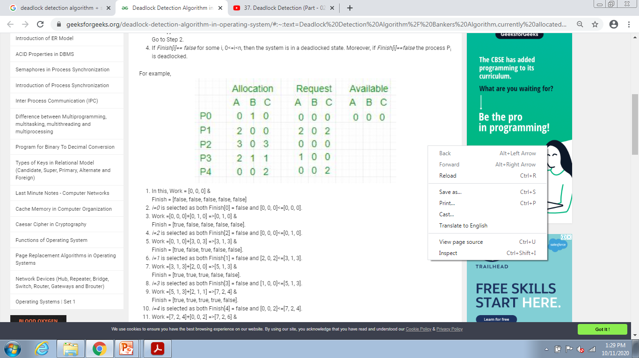
Several Instances of a Resource Type
m=no of resources
n=no of processes
Available
Allocation
Request
m
n
n x m

Slide 101
Detection Algorithm
m=no of resources
n=no of processes
1. Let Work and Finish be vectors of length m and n, respectively Initialize:
(a) Work = Available
(b) For i = 0,1,2, …, n-1, if Allocation_{i} ≠ 0, then Finish[i] = false; otherwise, Finish[i] = true
Initialize Work to Available and Finish to False
2. Find an index i such that both:
(a) Finish[i] == false
(b) Request_{i} ≤ Work
If no such i exists, go to step 4

Slide 102
Detection Algorithm (Cont.)
3. Work = Work + Allocation_{i} Finish[i] = true go to step 2
4. If Finish[i] == false, for some i, 1 ≤ i ≤ n, then the system is in deadlock state. Moreover, if Finish[i] == false, then P_{i} is deadlocked

Slide 103
Deadlock Detection
m=no of resources
n=no of processes
1. Let Work and Finish be vectors of length m and n, respectively Initialize:
(a) Work = Available
(b) For i = 0,1,2, …, n-1, if Allocation_{i} ≠ 0, then Finish[i] = false; otherwise, Finish[i] = true
Initialize Work to Available and Finish to False
2. Find an index i such that both:
(a) Finish[i] == false
(b) Request_{i} ≤ Work
If no such i exists, go to step 4
3. Work = Work + Allocation_{i} Finish[i] = true go to step 2
4. If Finish[i] == false, for some i, 1 ≤ i ≤ n, then the system is in deadlock state. Moreover, if Finish[i] == false, then P_{i} is deadlocked
Safety Algorithm
1. Let Work and Finish be vectors of length m and n, respectively. Initialize:
Work = Available
Finish [i] = false for i = 0, 1, …, n- 1
2. Find an i such that both:
(a) Finish [i] = false
(b) Need_{i} ≤ Work
If no such i exists, go to step 4
3. Work = Work + Allocation_{i} Finish[i] = true go to step 2
4. If Finish [i] == true for all i, then the system is in a safe state

Slide 104
Example of Detection Algorithm
Five processes P₀ through P₄; three resource types A (7 instances), B (2 instances), and C (6 instances)
Snapshot at time T₀:
Allocation Request Available
A B C A B C A B C
P₀ 0 1 0 0 0 0 0 0 0
P₁ 2 0 0 2 0 2
P₂ 3 0 3 0 0 0
P₃ 2 1 1 1 0 0
P₄ 0 0 2 0 0 2
Sequence <P₀, P₂, P₃, P₁, P₄> will result in Finish[i] = true for all i

Slide 105
Example of Detection Algorithm
Initially
Work = [0, 0, 0] &
Finish = [false, false, false, false, false]
i=0 is selected as both
Finish[0] = false and [0, 0, 0]<=[0, 0, 0]
Work =[0, 0, 0]+[0, 1, 0] =>[0, 1, 0] &
Finish = [true, false, false, false, false]
i=1 ,
Finish[1]=false and [2,0,2]!<=[0,1,0]
P1 should wait
i=2 is selected as both
Finish[2] = false and [0, 0, 0]<=[0, 1, 0]
Work =[0, 1, 0]+[3, 0, 3] =>[3, 1, 3]
Finish = [true, false, true, false, false]
Check If
(a) Finish[i] == false
Request_{i} ≤ Work
Then
Work = Work + Allocation_{i} Finish[i] = true

Slide 106
Example of Detection Algorithm
i=3 is selected as both
Finish[3] = false and [1, 0, 0]<=[3, 1, 3]
Work =[3, 1, 3]+[2, 1, 1] =>[5, 2, 4] &
Finish = [true, false, true, true, false]
i=4, is selected as both
Finish[4]=[false] and [0,0,2]<=[5,2,4]
Work=[5,2,4]+[0,0,2]=[5,2,6]
Finish = [true, false, true, true, true]
i=1 is selected as both
Finish[1] = false and [2, 0, 2]<=[5, 2, 6]
Work =[5, 2, 6]+[2, 0, 0] =>[7, 2, 6]
Finish = [true, true, true, true, true].
Check If
(a) Finish[i] == false
Request_{i} ≤ Work
Then
Work = Work + Allocation_{i} Finish[i] = true
If Finish[i] == false, for some i, 1 ≤ i ≤ n, then the system is in deadlock state.
No Finish[i] == false
No deadlock

Slide 107
Example (Cont.)
P₂ requests an additional instance of type C
Request
A B C
P₀ 0 0 0
P₁ 2 0 2
P₂ 0 0 1
P₃ 1 0 0
P₄ 0 0 2
Snapshot at time T0:
Allocation Request Available
A B C A B C A B C
P0 0 1 0 0 0 0 0 0 0
P1 2 0 0 2 0 2
P2 3 0 3 0 0 1
P3 2 1 1 1 0 0
P4 0 0 2 0 0 2
State of system?

Slide 108
Example of Detection Algorithm
Initially
Work = [0, 0, 0]
Finish = [false, false, false, false, false]
i=0 is selected as both
Finish[0] = false and [0, 0, 0]<=[0, 0, 0]
Work =[0, 0, 0]+[0, 1, 0] =>[0, 1, 0] &
Finish = [true, false, false, false, false]
i=1 ,
Finish[1]=false and [2,0,2]!<=[0,1,0]
P1 should wait
Finish = [true, false, false, false, false]
i=2 is selected as both
Finish[2] = false and [0, 0, 1]!<=[0, 1, 0]
P2 should wait
Finish = [true, false, false, false, false]
Check If
(a) Finish[i] == false
Request_{i} ≤ Work
Then
Work = Work + Allocation_{i} Finish[i] = true
1

Slide 109
Example of Detection Algorithm
i=3
Finish[3] = false and [1, 0, 0]!<=[0, 1, 0]
P3 should wait
Finish = [true, false, false, false, false]
i=4,
Finish[4]=[false] and [0,0,2]<=[0,1,0]
P4 should wait
Finish = [true, false, false, false, false]
Finish[i] of P1,P2,P3,P4 = false
So deadlock
Thus process P1,P2,P3,P4 are deadlocked.
Check If
(a) Finish[i] == false
Request_{i} ≤ Work
Then
Work = Work + Allocation_{i} Finish[i] = true
If Finish[i] == false, for some i, 1 ≤ i ≤ n, then the system is in deadlock state.
1

Slide 110
Example (Cont.)
State of system?
Can reclaim resources held by process P₀, but insufficient resources to fulfill other processes; requests
Deadlock exists, consisting of processes P₁, P₂, P₃, and P₄

Slide 111
Detection-Algorithm Usage
When should we invoke the detection algorithm?
Depends on:
How often a deadlock is likely to occur?
How many processes will need to be rolled back?
one for each disjoint cycle

Slide 112
Detection-Algorithm Usage
If deadlocks occur frequently,
then the detection algorithm should be invoked frequently.
Resources allocated to deadlocked processes will be idle until the deadlock can be broken.
In addition, the number of processes involved in the deadlock cycle may grow.

Slide 113
Detection-Algorithm Usage
If detection algorithm is invoked arbitrarily,
there may be many cycles in the resource graph and so we would not be able to tell which of the many deadlocked processes “caused” the deadlock.

Slide 114
Detection-Algorithm Usage
Invoking the deadlock-detection algorithm for every resource request
will incur considerable overhead in computation time.

Slide 115
Detection-Algorithm Usage
A less expensive alternative is simply to
invoke the algorithm at defined intervals-
for example, once per hour or whenever CPU utilization drops below 40 percent.

Slide 116
Recovery from Deadlock
When a detection algorithm determines that
a deadlock exists,
Several alternatives are available-
Let the operator deal with the deadlock manually.
Let the system recover from the deadlock automatically.

Slide 117
Recovery from Deadlock
There are two options for breaking a deadlock
Process Termination
Abort one or more processes to break the circular wait.
Resource Preemption
Preempt some resources from one or more of the deadlocked processes

Slide 118
Recovery from Deadlock: Process Termination
Eliminate deadlocks by aborting processes
The system reclaims all resources allocated to the terminated processes.
2 Methods-
Abort all deadlocked processes
Abort one process at a time until the deadlock cycle is eliminated

Slide 119
Recovery from Deadlock: Process Termination
Abort all deadlocked processes
Breaks the deadlock cycle, but at great expense;
The deadlocked processes may have computed for a long time,
The results of these partial computations must be discarded and probably will have to be recomputed later.

Slide 120
Recovery from Deadlock: Process Termination
Abort one process at a time until the deadlock cycle is eliminated.
Incurs considerable overhead, since after each process is aborted,
Deadlock-detection algorithm must be invoked to determine whether any processes are still deadlocked.

Slide 121
Recovery from Deadlock: Process Termination
Examples-
Aborting a process may not be easy.
If the process was in the midst of updating a file, terminating it
will leave that file in an incorrect state.
If the process was in the midst of printing data on a printer,
the system must reset the printer to a correct state before printing the next job.

Slide 122
Recovery from Deadlock: Process Termination
Abort those processes whose termination will incur the minimum cost.
In which order should we choose to abort?

Slide 123
Recovery from Deadlock: Process Termination
Many factors may affect -
Priority of the process
How long process has computed, and how much longer to completion
Resources the process has used
Resources process needs to complete
How many processes will need to be terminated
Is process interactive or batch?

Slide 124
Recovery from Deadlock: Resource Preemption
Successively preempt some resources from processes
Give these resources to other processes until the deadlock cycle is broken.
If preemption is used, 3 issues need to be addressed:
Selecting a victim
Rollback
Starvation

Slide 125
Recovery from Deadlock: Resource Preemption
Selecting a victim –
Which resources and Which Processes are to be pre-empted
determine the order of preemption to minimize cost.
Cost factors
as the number of resources a deadlocked process is holding
Amount of time the process has so far consumed during its execution

Slide 126
Recovery from Deadlock: Resource Preemption
Rollback – return to some safe state, restart process from that state

Slide 127
Recovery from Deadlock: Resource Preemption
Rollback –
If we pre-empt a resource from a process
Clearly, it cannot continue with its normal execution;
It is missing some needed resource.
What should be done with that process?
We must roll back the process to some safe state and restart it from that state.

Slide 128
Recovery from Deadlock: Resource Preemption
Safe State-
It is difficult to determine what a safe state is,
The simplest solution is a total rollback: abort the process and then restart it.
Although it is more effective to roll back the process only as far as necessary to break the deadlock, this method requires the system to keep more information about the state of all running processes.

Slide 129
Recovery from Deadlock: Resource Preemption
Starvation –
Same process may always be picked as victim,
How can we guarantee that resources will not always be pre-empted from the same process?
Ensure that a process can be picked as a victim" only a (small) finite number of times
Include number of rollback in cost factor

